Slide 1

BloomWatcher
NASA Earth-Observations Platform
Global Plant Bloom Detection, Monitoring, & Decision Support for a Changing World

Slide 2


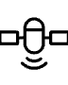





Executive Summary: Bridging Space Data with Earth Needs
NASA Earth Observations
Integrated Data Sources
Leveraging high-resolution data from MODIS, VIIRS, and EarthData APIs for comprehensive coverage.
Fusing satellite data with citizen-science observations and in-situ ground measurements.
Detection & Forecasting
Actionable Outputs
Accurately detecting, mapping, and forecasting plant blooming events on a global scale.
Delivering insights via intuitive dashboards, robust APIs, customized alerts, and detailed reports.
BloomWatcher supports critical sectors, including agriculture, conservation planning, and pollinator habitat management.

Slide 3





Core Objectives: Precision in Phenology
High-Resolution Detection
Accurately detect bloom onset and duration events at 250–500 meter resolution globally.
Anomaly & Visualization
Visualize current bloom activity against historical trends and identify significant phenological anomalies.
Short-Term Forecasting
Generate forecasts for bloom timing within a 1–4 week window using advanced machine learning models.
Robust Validation
Rigorously validate satellite detections using global citizen-science and established phenology networks.
Key Deliverables include a dynamic Web Dashboard, a comprehensive REST API, customizable Alert systems, and validated Datasets.

Slide 4




Key Datasets & NASA Infrastructure
BloomWatcher is built upon a foundation of reliable, publicly available NASA Earth Observation data and services, ensuring scalability and consistency.
MODIS & VIIRS Indices
NASA Data Access
MODIS Vegetation Indices (MOD13Q1) at 250 m resolution.
Utilizing NASA AppEEARS for efficient data extraction.
VIIRS Vegetation Indices (VNP13A1) at 500 m resolution.
Leveraging EarthData APIs for seamless integration.
Visualization Tools
Citizen Science Validation
Integration with NASA GIBS and Worldview for visual context and comparison.
Ground-truthing through iNaturalist observations.
Data correlation via the Global Biodiversity Information Facility (GBIF).

Slide 5
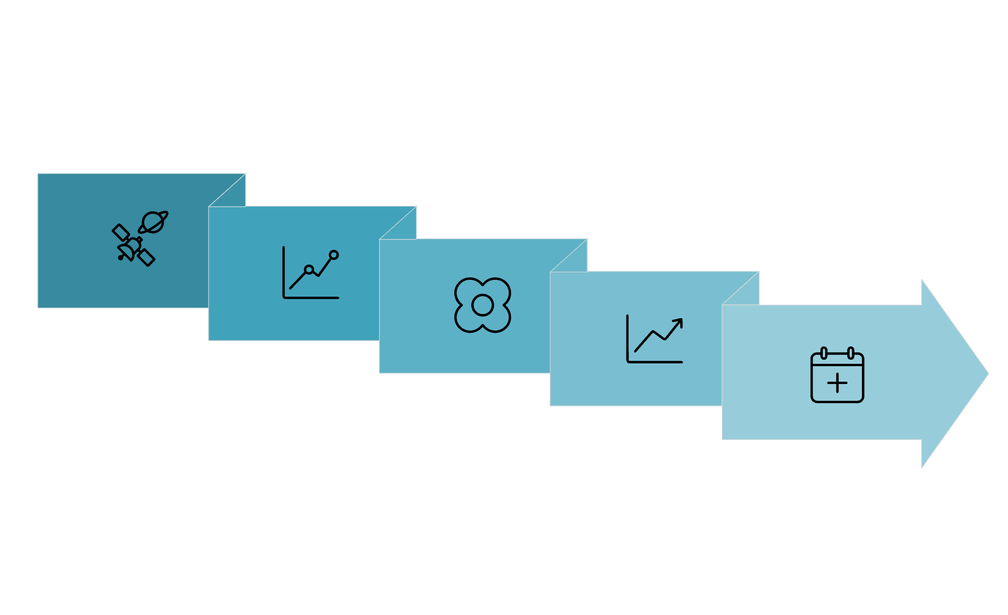
Scientific Approach: From Pixels to Prediction
Preprocessing
Event Detect
Validation
Smoothing
Forecasting
Data Preprocessing
Cleaning and preparing raw MODIS/VIIRS NDVI and EVI time-series data for analysis.
Smoothing & Analysis
Application of advanced techniques like Savitzky–Golay filters and TIMESAT methods to extract reliable
phenological metrics.
Bloom Event Detection
Employing a combination of established thresholds, change-point analysis, and Machine Learning classifiers to pinpoint bloom onset, peak, and end dates.
Advanced Forecasting
Integrating historical bloom calendars with recurrent neural networks (e.g., LSTM) for reliable
short-term forecasts.
Continuous Validation
Cross-referencing satellite detections with in-situ data from phenology and citizen-science
networks to maintain accuracy.

Slide 6

Scalable System Architecture
A modular, cloud-native architecture designed for global coverage and high-throughput data processing.
Data Ingest & Storage
Efficient ETL (Extract, Transform, Load) pipelines utilizing cloud-optimized GeoTIFFs (COGs) for accessibility.
Processing Backbone
Leveraging Dask and xarray for parallel processing and scalable extraction of phenology metrics across massive datasets.
Database Management
PostGIS database with optimized spatial indexing to handle and query georeferenced bloom event data efficiently.
Front-End & UX
Modern UI built with Godot & GD Script, featuring interactive mapping capabilities using Leaflet/MapLibre.
Automated Reporting
System for generating automated alerts and periodic reports based on user-defined monitoring regions.

Slide 7

Intuitive Visualization & User Experience
Global Bloom Heatmap
Interactive world map visualizing the current status and onset timing of bloom events across various biomes.
Region Explorer
Tools for zooming in on specific areas to view aggregated metrics and compare current data with historical averages.
Time-Series Analysis
Pixel inspector functionality allowing users to examine raw NDVI/EVI plots and phenological curve fitting at a specific location.
Custom Alerts & APIs
User-defined subscription services for alerts on phenological shifts and developer-friendly REST APIs for data integration.

Slide 8

Validation Plan & Key Performance Indicators (KPIs)
Rigorous validation ensures the trustworthiness and practical utility of the BloomSense platform for decision-making.
iNaturalist/GBIF
7 Days
0.8
Primary Validation Sources
Bloom Onset Accuracy (MAE)
Detection Precision Target
Required precision metric (P) of 0.8 or higher, ensuring minimal false positive detections of bloom events.
Cross-referencing satellite results with verified observational data from citizen-science networks and regional phenology programs.
Mean Absolute Error (MAE) for bloom onset timing must be maintained at 7 days or less compared to ground truth.
99%
System Reliability
Targeting high availability for the platform, ensuring decision-makers have continuous access to critical data.

Slide 9
Project Timeline: 12-Month Implementation Plan
1
2
Months 0–3
Months 3–6
Establish core data ingestion pipelines and develop the initial smoothing/processing prototype for time-series analysis.
Implement core bloom detection algorithms. Launch the first internal dashboard prototype for testing and feedback.
3
4
Months 6–9
Months 9–12
Scale the system for global operation. Integrate forecasting models (LSTM). Develop and deploy APIs and the alerts system.
Final validation against ground-truth data. Complete documentation. Polish and deploy the final operational dashboard.
This structured approach ensures rapid development and deployment of a fully validated and operational platform within the year.

Slide 10


Conclusion: Ready for Actionable Insights
BloomWatcher provides a scientifically robust, fully scalable solution for real-time phenological monitoring and forecasting.
Implementation-Ready: All core components leverage proven technologies and established methodologies.
Trusted Data Source: Built exclusively on NASA MODIS & VIIRS vegetation indices for global coverage.
Advanced Algorithms: Utilizes industry-standard phenology algorithms, including TIMESAT, for accurate detection.
Cloud Architecture: Scalable and reliable system designed on modern cloud/web architectures.
Actionable Outputs: Provides the critical data necessary for effective conservation, agriculture, and ecosystem management.

Slide 11
Team Spica
Shivam Chouhan
Samuel Fernandes

